Slide 1
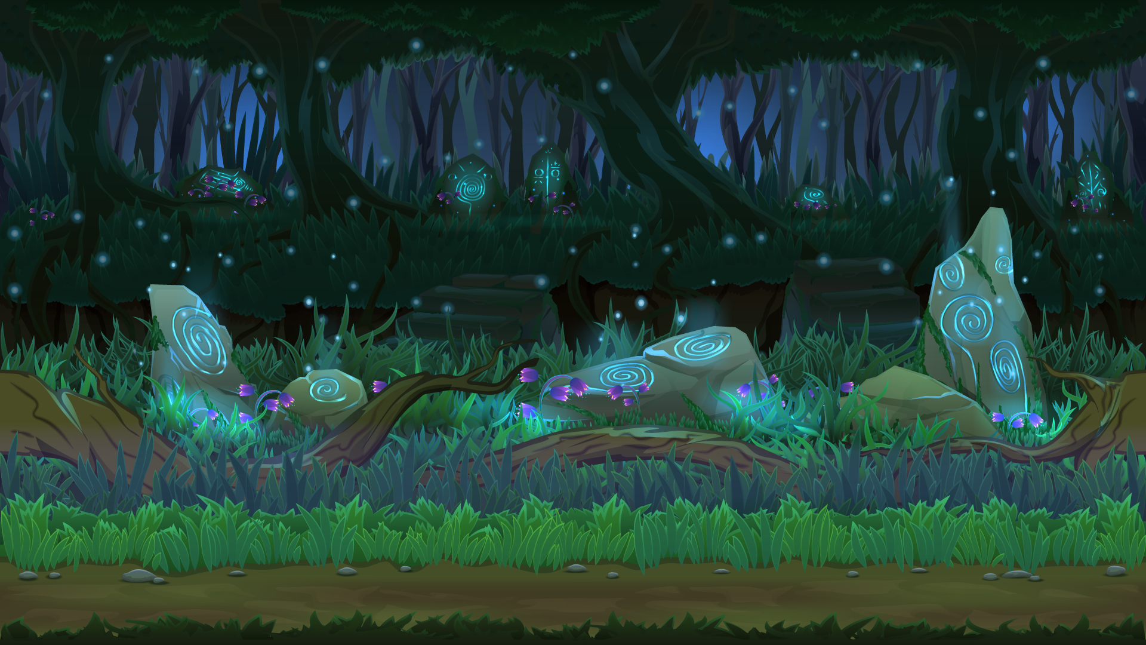
BLACK FOREST
Deniz Alakavuklar

Slide 2
About Me
Born and raised in Turkey
Lived 6 years in New Zealand and currently living in the Netherlands
A mom of a 7-year-old boy
Have Bachelor’s degree in Science (Mathematics)
Worked as a marketing specialist and buyer in big retailers such as Tesco.

Slide 3
Project
Black Forest is a simple game and includes one type of woman character. She can move along the game board and collects food (a slice of pie) to get points. She needs to be careful about the ghosts falling. Once she hits/touches one of the ghosts, the game is over. When the score is 200, the game is won.

Slide 4
Technical Issues
The biggest challenge is to make the collision better. The background of the character is transparent, so it makes hard to calculate the collision points.

Slide 5
Biggest Mistake
I had two mistakes and asked for help;
1) I couldn’t figure out how to make the food disappear when it is picked up. The solution is - the one picked up is simply removed from the array of resources.
2) When I restart the game, the character was continuously moving to the right. Once the “isMoving” variables are initialized in the restart, the problem is solved.

Slide 6
Demo
https://denizalakavuklar.github.io/Black-Forest/

Slide 7
…..THANK YOU …..

